Slide 1
Adena Health System
Contractor Orientation and
Safety Education

Slide 2
Adena Health System (AHS) Badges
Provide the AHS project manager the contractor’s name and work location (inside, outside, etc.) to get a AHS badge from security.
Return badges at the projects end or pay a $25 fee (not applicable to 1 day adhesive badges).
Wear AHS badges on the upper chest, facing forward and clearly visible.

Slide 3


AHS Dress Code
Clean and wipe off clothes and shoes before entering AHS buildings.
If clothing is excessively dusty from construction it is not permitted to be worn in the hospital.
Do not wear clothing with rips, tears, holes, questionable and/or offensive wording or pictures.

Slide 4
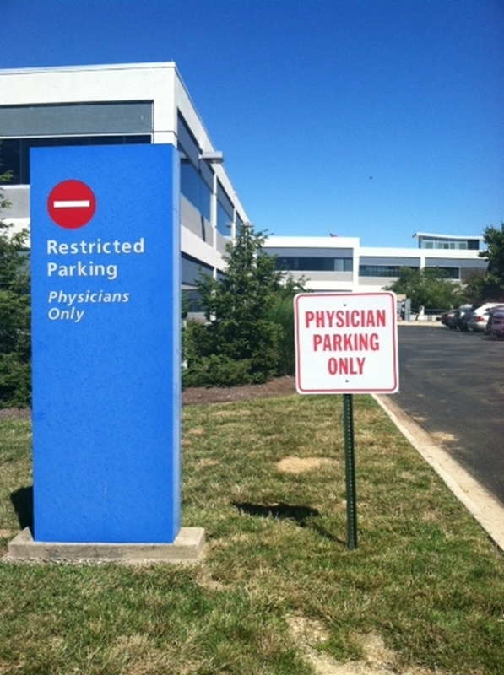
AHS Parking
Parking areas are determined in pre-construction meetings.
Number of company vehicles will be limited and this will also be determined in pre-construction meetings.
No personal vehicles are allowed.

Slide 5
AHS Contractor Guidelines
Contractors working on AHS property will follow AHS policies and will only use authorized entry points, elevators, restrooms, and eating areas.
Prior to commencement of any project the Contractors Project Manager will obtain and review the following policies with all contracted personnel (policies may be obtained from the AHS Construction Manager or Safety Officer):
Construction and Renovation Policy 800.016
Hot Work Permit Policy 900.005
Maintaining Fire/Smoke Rated Assemblies Policy 900.006
Confined Spaces Program 800.032

Slide 6
AHS Contractor Guidelines continued
Important Contact Numbers
Department Name | Phone Number
Switchboard Operator | 740-779-7500
Construction Manager | 740-779-7502
Safety Officer | 740-779-8681
Building/Plant Supervisor | 740-779-7506
Facility Operations | 740-779-7368 or 7509
Infection Prevention | 740-779-8118
Adena Police/Security | 740-779-7505
Environmental Services | 740-779-7968

Slide 7
AHS Contractor Guidelines continued
Before entering Adena Health System property, please make sure you are wearing your:
AHS Badge
Hard Hat
Safety glasses and/or other PPE
Complete the AHS Construction Daily Worksite Inspection Checklist (Click on Daily Checklist on the Contractor home page)

Slide 8

AHS Contractor Guidelines continued
No smoking in any buildings or outdoor areas owned and/or operated by Adena Health System
Eating and drinking shall be limited to designated break areas (water is ok inside the construction area)

Slide 9
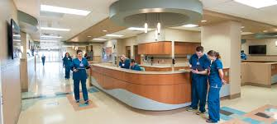
AHS Contractor Guidelines continued
Patients, staff and visitors ALWAYS have the right-of-way in elevators and hallways
Clear pathways for patients, staff and visitors
Do not slow down day-to-day AHS operations

Slide 10


AHS Contractor Guidelines continued
Use provided hand-cleaning products often, especially if the work space is in or near patient care
Reduce noise as much as possible
Provide the highest level of customer service to our patients, staff and visitors

Slide 11


AHS General Privacy Guidelines
DO NOT look in patient or procedure rooms
Follow the “3 second look” rule
Avoid foul language and extremely loud conversations
Respect all AHS patients’, staff and visitors’ privacy
If a complaint is reported by a patient, visitor or staff member for inappropriate behavior or breach of privacy,
AHS reserves the right to remove any contractor
that is reported for inappropriate
behavior or privacy breaches.

Slide 12

AHS After-Hours Work Guidelines
To complete after-hours work, notify the AHS Project Manager at least 24 hours in advance

Slide 13
AHS Utility Shutdowns
Notify Facility Operations during normal business hours at 740-779-7368 of shutdowns for electrical, plumbing, smoke detection and fire/sprinkler systems
Scheduled shutdowns require a 2-week notification in writing (including email)
Unanticipated shutdowns require a 48-hour notification
In the event of an unplanned utility outage immediately notify the following during normal business hours:
  Facility Operations at 740-779-7368 and Security at 740-779-7505
  Safety Officer at 740-779-8681 or call the Switchboard Operator at 740-779-7500 and ask to be put through to the Safety Officer cell phone for a utility outage emergency
  After normal business hours call 740-779-7500 and have the Maintenance Technician on call/duty paged and notify Security

Slide 14

AHS Infection Control Risk Assessment (ICRA)
Complete the Infection Control Risk Assessment (ICRA) before the project’s start to minimize patient risk to dust, moisture, and debris.
To obtain this form, the ICRA inspection monitor form and a copy of the Construction and Renovation Policy 800.016 contact the AHS Project Manager or AHS Safety Officer.
The ICRA must include:
  Start and planned completion dates
  Project description
  Additional requirements (if applicable)
When the contractor portion is complete return the form via email to the AHS Project Manager, Safety Officer or Infection Prevention Manager. When all three have approved and signed off the Infection Control Permit will be issued. An electronic copy will be retained by AHS.

Slide 15
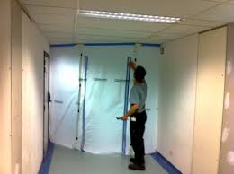
AHS ICRA continued
A laminated copy of the Infection Control Permit must be posted at the project site until project completion
If the project exceeds the stated completion date, the AHS Project Manager must contact Infection Prevention for an extension
ICRA inspection monitor forms must be completed daily or weekly (frequency to be determined by Infection Prevention Manager)
Completed forms are to be returned to the AHS Safety Officer

Slide 16

AHS ICRA continued
Infection Prevention staff, Safety staff, or the department Director/Supervisor have the authority to stop the project if any part of the ICRA is violated
Contact the AHS Project Manager immediately if problems arise
Project may resume when issues are resolved to the satisfaction of the party that shutdown the project

Slide 17


AHS Interim Life Safety Measures (ILSM)
If construction, renovation, or alteration activities might cause a failure in existing Life Safety Code building features, including but not limited to:
  Emergency Exits
  Access for emergency services
  Fire extinguisher equipment
  Fire alarms
  Fire suppression systems
The ILSM grid is part of the Pre-Construction Risk Assessment (PCRA) and may be obtained from the AHS Project Manager or Safety Officer (740-779-8681).
Fill out the ILSM grid during project development and monitor continuously until the project’s completion when required. Completed monitoring forms are to be returned to the AHS Safety Officer. Contact the AHS Safety Officer if you feel the dust you create may affect the smoke alarm system.

Slide 18
AHS Containment Measures
The AHS Project Manager is responsible for:
  Collaborating with the Department Director/Manager to ensure all patients will be moved prior to commencement of work
  Collaborating with AHS Plant/Building Supervisor to ensure HVAC system isolation (blocking return air grills and duct work when necessary) is complete prior to commencement of work to avoid dust contamination of surrounding areas
  Coordinating use of HEPA filtration units for negative air pressure to exhaust air

Slide 19
AHS Containment Measures continued
The Contractor is responsible for:
  Cleaning and sealing ceiling vents.
  Wiping down tools and equipment with a damp cloth or bagging them before bringing them through the hospital. This includes tool/trash carts, covers and wheels.
  Using fire-rated plastic for all short term jobs.
  Taping barrier seams to make sure they are fully sealed – NO DROOPING!
  Installing temporary floor-to-deck barriers as needed.
  Installing solid-wall barriers for longer projects as needed.
  Using tightly sealed barriers/control cubes to contain all work, including holes in the walls, ceilings and floors.

Slide 20
AHS Containment Measures continued
Contractor responsibilities continued:
Properly sealing doors into barrier areas with zipper
DO NOT use control cubes with broken zippers
Sealing wall/ceiling/floor openings with an approved UL sleeve and Hilti, STI or 3M UL listed fire stop systems (obtain copy of Maintaining Fire/Smoke Rated Assemblies policy 900.006 from AHS Construction Manager or Safety Officer).
Do any assembly or cutting of pipe, wood or other materials inside the designated work area or outside of the building.
Use walk-off mats (sticky or moistened carpet mats) between your work area and the rest of the building (peel sticky mats to the next layer as soon as they lose adhesive quality).
Vacuum carpet mats daily.

Slide 21
AHS Containment Measures High Risk Areas
  Use the following special requirements for high risk areas:
  Construct an anteroom to ensure an airtight enclosure of the project site
  Use HEPA filtration units for negative air pressure within the work site
  Check ventilation filters regularly for leaks or clogs
  Use PPE as needed
  Remove disposable coveralls and disposable booties before leaving the demolition area
  Use HEPA vacuums (inside anteroom) to vacuum clothing/boots upon exit of project site when disposable coveralls are not required

Slide 22



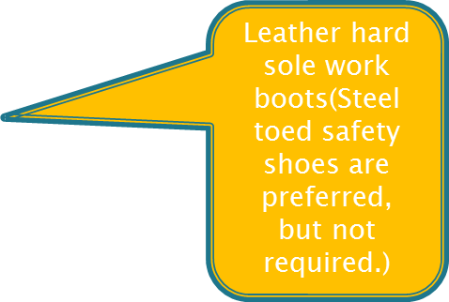
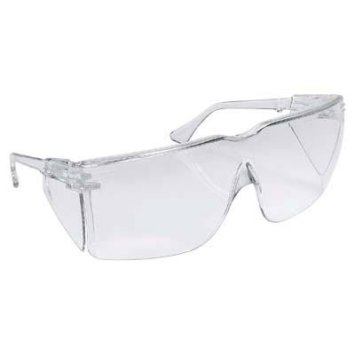
AHS PPE Requirements
These are minimum PPE requirements. Additional PPE may be required based on the task and/or scope of work performed. See your supervisor if you are unsure of the PPE required for the task(s) you are performing.
Safety Glasses (must be ANSI Z87 approved with fixed side shields)

Slide 23
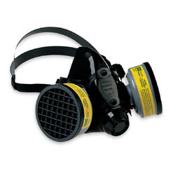
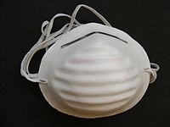
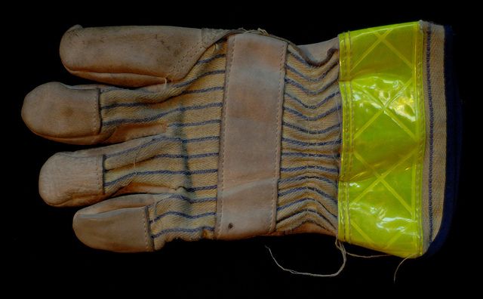
AHS PPE Requirements continued
These are minimum PPE requirements. Additional PPE may be required based on the task and/or scope of work performed. See your supervisor if you are unsure of the PPE required for the task(s) you are performing.
Gloves (applicable for the type of work being done)
Respiratory protection (applicable for they type of work being done)

Slide 24


AHS PPE Requirements continued
Hearing protection in areas where the noise level exceeds 85 db. (If you have to raise your voice to be heard by someone within 3’ of you, the noise level is above 85 db.)

Slide 25


AHS Waste Guidelines
Dispose of all waste.
Construction site waste must be disposed of daily. If waste is being removed from occupied buildings it must be done using a covered dumpster.
Contractors requiring waste collection on site must coordinate with the AHS Project Manager.
Location, size, duration and frequency of dumps must be communicated to the AHS Project Manager.

Slide 26
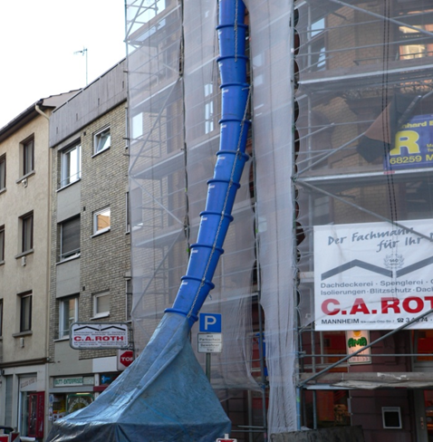
AHS Waste Guidelines continued
If a construction chute is used, it must be sealed to prevent the accidental spread of debris

Slide 27

AHS Cleaning Guidelines
Establish traffic patterns to prevent dust from being taken outside the construction area and clean up all dust immediately
Clean all areas adjacent to the project site often, using a damp mop (change water often) of HEPA vacuum to control dust
Do not use a broom as it stirs up dust

Slide 28
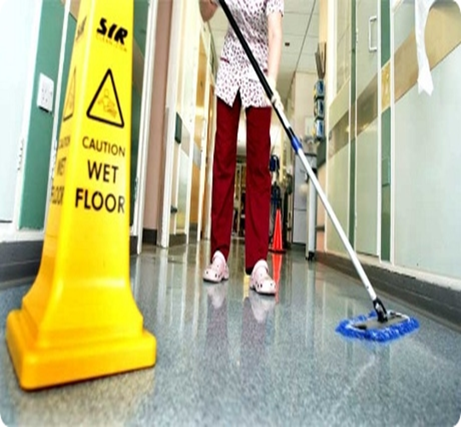
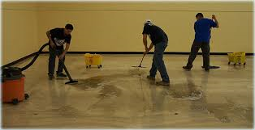
AHS Cleaning Guidelines continued
When project is complete, clean the work area
When work area is clean, carefully remove barriers
Contact Environmental Services (740-779-7968) to clean the completed project area before allowing patients to return

Slide 29

AHS Electrical Safety Guidelines
Ensure all electrical equipment is UL rated and in good working condition
Do not plug equipment into red outlets
A Ground Fault Circuit Interrupter (GFCI) must be plugged into the outlet before plugging in any other equipment or cords

Slide 30
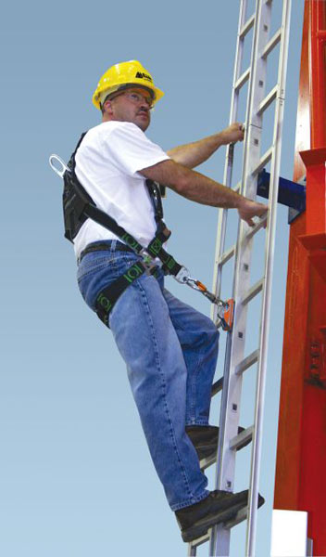
AHS Ladder Safety Guidelines
Always maintain a 3-point
(two hands and a foot, or
two feet and a hand) contact
on the ladder when
climbing. Keep your body
near the middle of the step
and always face the ladder
while climbing.
Only use ladders and appropriate
accessories (ladder
levelers, jacks or hooks) for
their designed purposes.

Slide 31
AHS Ladder Safety continued
Ladders must be free of any slippery material on the rungs, steps or feet.
Do not use a self-supporting ladder (e.g., step ladder) as a single ladder or in a partially closed position.
Do not use the top step/rung of a ladder as a step/rung unless it was designed for that purpose.
Use a ladder only on a stable and level surface, unless it has been secured (top or bottom) to
prevent displacement.

Slide 32
AHS Ladder Safety continued
Do not place a ladder on boxes, barrels or other unstable bases to obtain additional height.
Do not move or shift a ladder while a person or equipment is on the ladder.
An extension or straight ladder used to access an elevated surface must extend at least 3 feet above the point of support. Do not stand on the three top rungs of a straight, single or extension ladder.

Slide 33
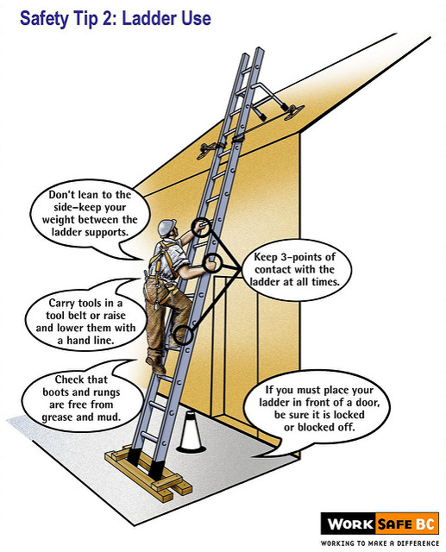
AHS Ladder Safety continued
The proper angle for
setting up a ladder is to
place its base a quarter
of the working length of
the ladder from the wall
or other vertical surface.
A ladder placed in any
location where it can
be displaced by other
work activities must
be secured to prevent
displacement or a barricade must be erected to
keep traffic away from the ladder.

Slide 34
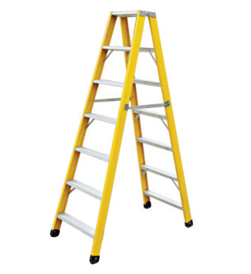
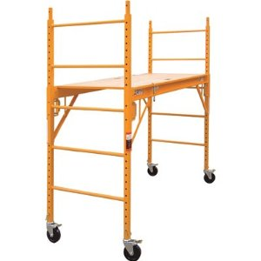

AHS Ladder Safety continued
Be sure that all locks on an extension ladder or any elevated work platform are properly engaged.
Do not exceed the maximum load rating of any elevated work platform or ladder. Be aware of the load rating and of the weight it is supporting, including the weight of any tools or equipment.

Slide 35
AHS Fall Prevention Guidelines
Fall protection is required for any work conducted at a height of 6’ or greater
Wear a harness and always stay connected
Make sure your harness fits
Use guardrails or lifelines
Inspect all fall protection equipment before use
Guard or cover all holes, openings, and skylights
DON’T disconnect from the lifeline
DON’T work around unprotected openings or skylights
DON’T use defective equipment
Information on ladder safety and fall prevention obtained from osha.gov

Slide 36

Safety Data Sheets
Contractors will provide Safety Data Sheets (SDS) to the AHS Safety Department Coordinator for any materials that will be used on site
The SDS for any materials in the AHS area where work is being performed will be made available to the Contractor upon request.
Please submit SDS requests to the AHS Safety Department Coordinator
Jennifer Abner-Safety Services 3rd Floor

Slide 37
AHS Hazardous Chemical Guidelines
Do not use any extremely hazardous chemicals, aerosol sprays, or cleaning products that produce heavy fumes or odors, without first notifying the AHS Safety Officer (740-779-8681).
Observe all safety and environmental precautions when using hazardous chemicals on AHS property.
Dispose of all chemicals off site. If you bring it – take it away when you leave (including empty cans, bottles, etc.)

Slide 38
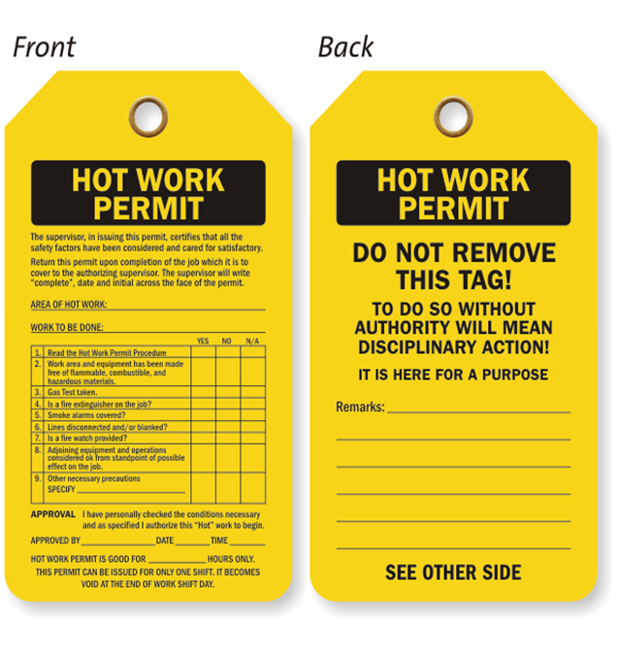
AHS Hot Work Permits
Obtain a Hot Work Permit for all welding, cutting, grinding or any other type of work that might create a spark
Obtain Hot Work Permits through Security (740-779-7505)
See AHS Hot Work Permit Policy 900.005 for details

Slide 39
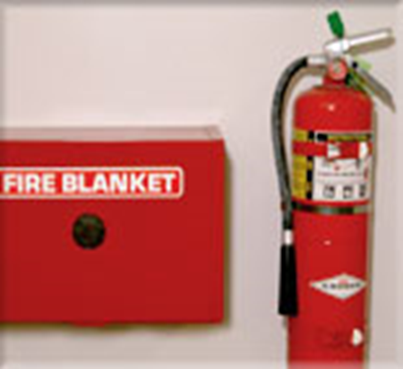
AHS Hot Work Permits continued
Once the Hot Work Permit is obtained, the contractor must contact Security (740-779-7505) in person before and after the work is completed to sign off on where the work is being performed so the fire alarm system can be isolated if necessary
The Hot Work Permit must be returned to the issuer once Hot Work is completed
The Contractor must provide fire extinguishers and blankets (if necessary)

Slide 40
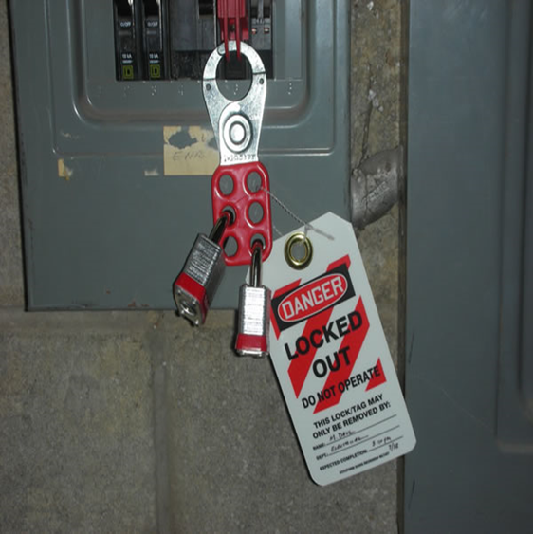
AHS Lockout/Tag-out Guidelines
Facility Operations approves the lockout/tag-out of equipment before work on the equipment is performed and a point of contact is established.
When AHS personnel lockout/tag-out a piece of equipment for a contractor, the contractor is also required to add a lock or tag using a multilock device.
All locks must have a tag with contact information.

Slide 41
AHS Confined Space Guidelines
Coordinate a permit for all entries into any confined space through your AHS Project Manager. Obtain a copy of AHS Confined Spaces Program Policy 800.032 and use permits and forms as appropriate (Appendix A & B).
The Contractor will inform the AHS Project Manager of contracted personnel procedures for entering confined spaces.
The AHS Project Manager will inform the Contractor of all the procedures and precautions in or near the confined space and will conduct a debrief with the Contractor at the end of the job to learn of any hazards found or created during entry.

Slide 42


AHS Bloodborne Pathogens Guidelines
Bloodborne pathogens are viruses (such as HIV and Hepatitis B & C) found in blood or certain body fluids
A person has to come in direct contact, usually through a needle stick, to become infected
You cannot get a bloodborne pathogen infection by casual contact

Slide 43


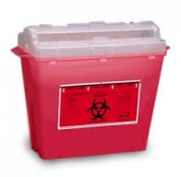
Bloodborne Pathogens Guidelines continued
If you are exposed to blood or body fluids:
what you are doing
Dispose of any sharps involved in an approved sharps container
Wash the exposed area with soap and water
Report it to your Supervisor

Slide 44

AHS Injury Guidelines
Contracted employees must notify their Supervisor of injuries and follow company policy and procedures.
The Supervisor must notify the AHS Project Manager and provide an incident report.
In the event that a construction accident occurs, the construction supervisor present at the time will contact 911 for any medical emergency as deemed necessary.
It is important to know the physical address of the location of the jobsite in the event you need to call 911.
The construction supervisor will also contact Adena Police & Security at 740-779-7505 and request hospital security to be dispatched to the accident scene.

Slide 45
AHS Emergency Codes
Code Red Fire
Code Adam Infant/Child Abduction
Code Black Bomb/Bomb Threat
Code Gray Severe Weather
Code Orange Hazardous Material Spill
Code Blue Medical Emergency - Adult
Code Pink Medical Emergency - Pediatric
Code Yellow Disaster
Code Violet Violent Person
Code Silver Person with Weapon / Hostage Situation
Code Brown Missing Adult Patient/Visitor
Code Green Evacuation of Building
Code Email Check your email for Instructions

Slide 46

AHS Emergency Codes continued
Code Red: FIRE
Follow the RACE / PASS guidelines
  R: Rescue people in the fire area
  A: Activate the Alarm (pull box)
  C: Contain the fire (close doors)
  E: Evacuate (people from the area)

Slide 47


Workplace Violence
Adena strictly prohibits violence in the workplace by any individual, in any form. Violence can be defined as any physical assault, threatening behavior or verbal abuse occurring in the work setting or related to the workplace.
  Report all incidents of workplace violence immediately.
  For Main Campus – Contact Security/Human Resources Department to report threatening behavior. Call 27555, state CODE Violet and location for violent/potentially violent or escalating behavior.
  For Regional Sites – Contact the Site Manager and the Main Campus Security Officer on duty or Human Services Department to report threatening behavior.
  If you are in an isolated area and are unable to reach a phone, use whatever is available to draw attention to you, i.e. pull a fire alarm box, etc.
  If you are aware of potential workplace violence (i.e. restraining order, incidence of violence outside the workplace), notify your department director and the Main Campus Security Officer on duty.
  A Workplace Violence “Tool Kit” was created that has additional information that may be needed. The tool kit has policy references, various forms, additional contact information etc. You can find this toolkit by accessing the Adenanet and clicking on the following: Departments/ Safety/ Workplace Violence.

Slide 48
AHS Emergency Codes continued
When a code is announced over the public address system you must:
  Cease any electrical and hot work
  Secure ladders and clear all equipment from the hallways
  Follow the direction of the AHS Project Manager, Adena Police/Security, Safety Officer and/or Department Director/Manager

Slide 49
This completes the presentation – What Now?
The following slide is a sign-off sheet for this presentation. It is slide 49. You DO NOT have to print the entire presentation.
Click on Print
Enter 49 in the Pages/Slides box
Click on print again
Bring the hard copy of the completed form to the AHS Safety Office (check in with Adena Police/Security for directions), or scan and email to jabner@adena.org
Go back to the Contractor home page and click on TAKE TEST
Both of these items are required

Slide 50

AHS Contractor Orientation/Safety Education Sign-Off Sheet
I, , have read and fully understand the information provided in this packet/presentation. I have been offered instruction on the information in the event clarification was needed and have also been offered the opportunity to ask questions.
Signature:
Company:
Date:

