Slide 1
Adena Health System Contracted Services Orientation and Safety Education

Slide 2
Adena Health System (AHS) Badges
Health screening requirements are not at the expense of Adena.
Contact Adena Occupational Health to set up an account if using these services to meet the requirements:
1-(740)-779-7813
Screening may consist of immunizations, 2TB tests, and if it is October-March, a flu shot.
Must have Occupational Health sign off to get badge from HR.
48 hours in advance of start date is necessary to begin screening.
Bring immunization records if necessary.
Contractors must complete a Contracted Employee Orientation Instructions and Affirmation Statement.

Slide 3
Adena Health System (AHS) Badges cont’
This form will be provided by the AHS Manager/Director overseeing the service. It may also be obtained from People Services.
When all required forms and applicable required health screenings have been completed an AHS badge will be issued.
Return badges at the contracted services end or pay a $25 fee (not applicable to 1 day adhesive badges).
Wear AHS badges on the upper chest, facing forward and clearly visible.

Slide 4
AHS General Dress Code Guidelines
Contractors are expected to use good judgment in regard to their personal appearance. Cleanliness and good hygiene are expected of all contractors.
Clean and wipe off clothes and shoes before entering AHS buildings.
Do not wear clothing with rips, tears, holes, questionable and/or offensive wording or pictures.

Slide 5
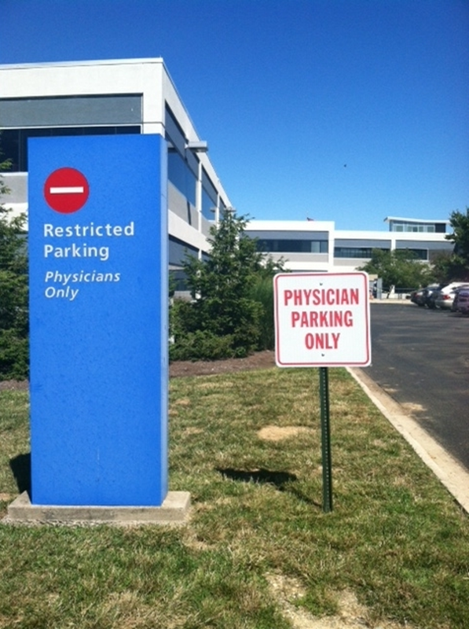
AHS General Parking Guidelines
Contractors are not permitted to park on gravel islands. Parking next to the building must be limited to loading/unloading materials only. Contractors are to park in the farthest available space from the building in Employee lots.

Slide 6
AHS General Contractor Guidelines
Important Contact Numbers
Department Name | Phone Number
Switchboard Operator | 740-779-7500
ARMC Safety Officer | 740-779-8681
ARMC Facility Operations | 740-779-7368 or 7509
Infection Prevention | 740-779-8118
Adena Police/Security | 740-779-7505
Environmental Services | 740-779-7968
APMC Security Officer | 740-703-4940
APMC Facilities Manager | 740-947-6355
AGMC Security Officer | 740-466-6584
AGMC Facilities Manager | 937-981-4909

Slide 7
AHS Contractor Guidelines continued
No smoking in any buildings or outdoor areas owned and/or operated by Adena Health System
Eating and drinking shall be limited to designated break areas.

Slide 8
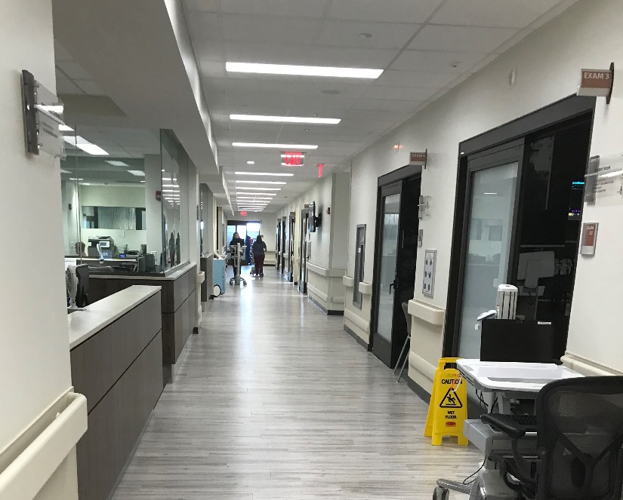
AHS Contractor Guidelines continued
Patients, staff and visitors ALWAYS have the right-of-way in elevators and hallways
Clear pathways for patients, staff and visitors
Do not slow down day-to-day AHS operations

Slide 9
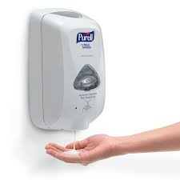
AHS Contractor Guidelines continued
Use provided hand-cleaning products often, especially if the work space is in or near patient care
Reduce noise as much as possible
Provide the highest level of customer service to our patients, staff and visitors

Slide 10
AHS General Privacy Guidelines
DO NOT look in patient or procedure rooms
Follow the “3 second look” rule
Avoid foul language and extremely loud conversations
Respect all AHS patients’, staff and visitors’ privacy
If a complaint is reported by a patient, visitor or staff member for inappropriate behavior or breach of privacy,
AHS reserves the right to remove any contractor
that is reported for inappropriate
behavior or privacy breaches.

Slide 11
AHS General Fire Safety Guidelines
Code Red: FIRE
Follow the RACE/PASS guidelines
R: Remove persons from immediate area
A: Pull nearest Fire Alarm
C: Close all open doors to contain the fire
E: Use a fire extinguisher to extinguish the fire

Slide 12
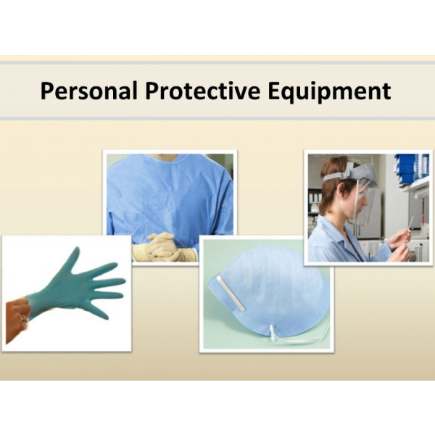
AHS PPE General Guidelines
PPE may be required based on the task and/or scope of work performed. See your supervisor if you are unsure of the PPE required for the task(s) you are performing.

Slide 13
AHS Electrical Safety Guidelines
Ensure all electrical equipment is UL rated and in good working condition
Do not plug equipment into red outlets
A Ground Fault Circuit Interrupter (GFCI) must be used near water sources

Slide 14
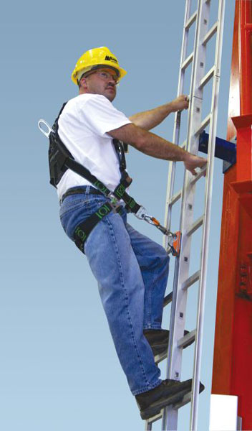
AHS Ladder Safety Guidelines
Always maintain a 3-point
(two hands and a foot, or two feet and a hand)
Contact on the ladder when climbing. Keep
your body near the middle of the step and
always face the ladder while climbing.
Only use ladders and appropriate accessories
(ladder levelers, jacks or hooks) for their
designed purposes.
Ladders must be free of any slippery material
on the rungs, steps or feet.
Do not use a self-supporting ladder (e.g., step
ladder) as a single ladder or in a partially closed
position.
Do not use the top step/rung of a ladder as a step/rung unless it was designed for that purpose.

Slide 15
AHS Ladder Safety continued
Do not use the top step/rung of a ladder as a step/rung unless it was designed for that purpose.
Use a ladder only on a stable and level surface, unless it has been secured
(top or bottom) to prevent displacement.
Do not place a ladder on boxes, barrels or other unstable bases to obtain
additional height.
Do not move or shift a ladder while a person or equipment is on the ladder.
An extension or straight ladder used to access an elevated surface must extend at least 3 feet above the point of support. Do not stand on the three top rungs of a straight, single or extension ladder.
The proper angle for setting up a ladder is to place its base a quarter of the working length of the ladder from the wall or other vertical surface. A ladder placed in any
location where it can be displaced by other work activities must be secured to prevent
displacement or a barricade must be erected to keep traffic away from the ladder.

Slide 16
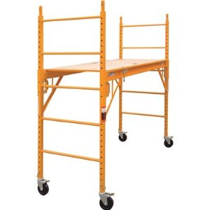
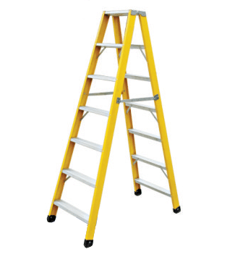
AHS Ladder Safety continued
Be sure that all locks on an extension ladder or any elevated work platform are properly engaged.
Do not exceed the maximum load rating of any elevated work platform or ladder. Be aware of the load rating and of the weight it is supporting, including the weight of any tools or equipment.

Slide 17
AHS Fall Prevention Guidelines
Fall protection is required for any work conducted at a height of 6’ or greater
Wear a harness and always stay connected
Make sure your harness fits
Use guardrails or lifelines
Inspect all fall protection equipment before use
Guard or cover all holes, openings, and skylights
DON’T disconnect from the lifeline
DON’T work around unprotected openings or skylights
DON’T use defective equipment
Information on ladder safety and fall prevention obtained from osha.gov

Slide 18
Safety Data Sheets
Contractors will provide Safety Data Sheets (SDS) to the AHS Safety Department Coordinator for any materials that will be used on site
The SDS for any materials in the AHS area where work is being performed will be made available to the Contractor upon request.
Please submit SDS requests to the AHS Safety Department Coordinator
Jennifer Abner-Safety Services 3rd Floor

Slide 19
AHS Hazardous Chemical Guidelines
Do not use any extremely hazardous chemicals, aerosol sprays, or cleaning products that produce heavy fumes or odors, without first notifying the:
AHS Safety Officer (740-779-8681)
Observe all safety and environmental precautions when using hazardous chemicals on AHS property.
Dispose of all chemicals off site. If you bring it – take it away when you leave (including empty cans, bottles, etc.)

Slide 20
AHS Bloodborne Pathogens Guidelines
Bloodborne pathogens are viruses (such as HIV and Hepatitis B & C) found in blood or certain body fluids
A person has to come in direct contact, usually through a needle stick, to become infected
You cannot get a bloodborne pathogen infection by casual contact

Slide 21
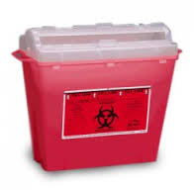
Bloodborne Pathogens Guidelines continued
If you are exposed to blood or body fluids:
what you are doing!
Dispose of any sharps involved in an approved sharps container
Wash the exposed area with soap and water
Report it to your Supervisor

Slide 22
AHS General Injury Guidelines
The Supervisor must notify the AHS Project Manager and provide an incident report
Visitors that fall or have been injured on Health System property should be referred for a medical evaluation
On the main campus, during normal business hours, offer the visitor an evaluation at the Occupational Health Center. After normal business hours, refer the visitor to the Emergency Department
Complete an incident report as soon as possible. The incident report serves as notice to the Patient Safety Officer to determine if additional investigation of the incident is needed
The Risk Manager, in collaboration with the treating physician, will review and determine if follow-up, further action, and additional complementary treatment is indicated
After the initial visit, visitors requiring follow-up or additional treatment should be referred to their Primary Care Physician.
Notify Risk Management as soon as possible at
740-779-7134 or 740-779-7784
At Regional Sites, offer the visitor an evaluation at the Urgent Care or provider located at the site. At AGMC and APMC, offer the visitor an evaluation in the Emergency Department
Visitors receiving treatment must be registered as a referred patient, using client "BD Adena Administrative Review" as the insurance (acct. #300000) for this visit only
Contracted employees must notify their Supervisor of injuries and follow Adena policy and procedures

Slide 23
AHS Emergency Codes
Code Red Fire
Code Adam Infant/Child Abduction
Code Black Bomb/Bomb Threat
Code Gray Severe Weather
Code Orange Hazardous Material Spill
Code Blue Medical Emergency - Adult
Code Pink Medical Emergency - Pediatric
Code Yellow Disaster
Code Violet Violent Person
Code Silver Person with Weapon / Hostage Situation
Code Brown Missing Adult Patient/Visitor
Code Green Evacuation of Building
Code Email Check your email for Instructions

Slide 24
AHS General Safety Guidelines
Report all work injuries and illnesses immediately
Report all Unsafe Acts or Unsafe Conditions to your Supervisor
Firearms, weapons, or explosives are not permitted on Adena Property.
Use, possession, sale or being under the influence of illegal drugs, misuse of prescription drugs and/or alcohol is not permitted on Adena Property or while "on duty".
Only authorized and trained Employees may enter a posted Confined Space. All confined spaces will be posted Confined Space - Permit Required. Entry is allowed only after permits are properly issued.
Only authorized and trained Employees may dispense or use chemicals. It is your responsibility to know where SDS's (Safety Data Sheets) are located and that they are available for your use and review
Keep work areas clean and aisles clear. Do not block emergency equipment or exits.
Wear and use the prescribed Personal Protective Safety Equipment. This includes foot protection, head protection, gloves, etc.
Smoking is not permitted on all Adena Health System property
Follow the direction of the AHS Project Manager, Adena Police/Security, Safety Officer and/or Department Director/Manager
Only authorized and trained Employees may repair or adjust machinery and equipment. Lock and Tag Out Procedures must be followed
Only qualified and trained Employees may work on or near Exposed Energized Electrical Parts or Electrical Equipment.

Slide 25
This completes the presentation – What Now?
The following slide is a sign-off sheet for this presentation. It is slide 26. You DO NOT have to print the entire presentation.
Click on Print
Enter 26 in the Pages/Slides box
Click on print again
Bring the hard copy of the completed form to the facilities Safety Office…. Adena Regional- Please see Jennifer Abner- 3rd Floor-Safety Services
Adena Greenfield & Adena Pike- Scan and email to jabner@adena.org
Go back to the Contractor home page and click on TAKE TEST
Both of these items are required

Slide 26
AHS Contractor Orientation/Safety Education Sign-Off Sheet
I, , have read and fully understand the information provided in this packet/presentation. I have been offered instruction on the information in the event clarification was needed and have also been offered the opportunity to ask questions.
Signature:
Company:
Date:

