Slide 1
Adena Health Contractor Orientation and Safety Education
(Construction Worker)

Slide 2
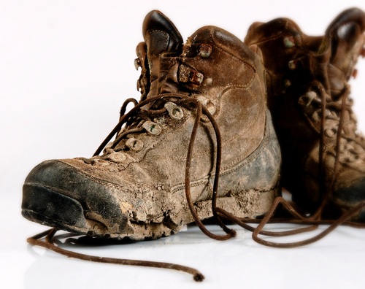
Dress Code
Clean and wipe off clothes and shoes before entering Adena Health buildings.
If clothing is excessively dusty from construction it is not permitted to be worn in the hospital.
Do not wear clothing with rips, tears, holes, questionable and/or offensive wording or pictures.

Slide 3
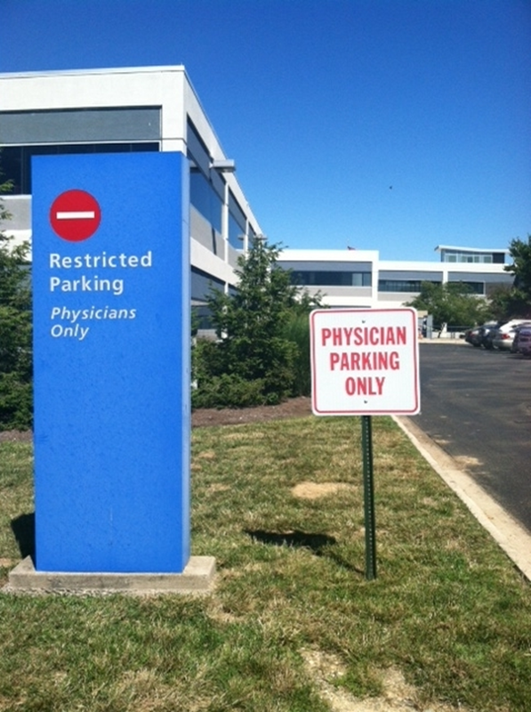
Parking
Parking areas are determined in pre-construction meetings.
Number of company vehicles will be limited and this will also be determined in pre-construction meetings.
No personal vehicles are allowed.

Slide 4
Contractor Guidelines
Contractors working on Adena Health property will follow Adena Health policies and will only use authorized entry points, elevators, restrooms, and eating areas.
Prior to commencement of any project the Contractors Project Manager will obtain and review the following policies with all contracted personnel (policies may be obtained from the Adena Health Director of Facility Planning and Construction or Adena Health Safety Officer):
Construction and Renovation Policy 800.016
Hot Work Permit Policy 900.005
Maintaining Fire/Smoke Rated Assemblies Policy 900.006
Confined Spaces Program 800.032
Lockout/Tagout Hazardous Energy Control, 800.026
Electrical Equipment Safety, 800.010
AHS Water Management Program

Slide 5
Contractor Guidelines continued
Important Contact Numbers
Department Name | Phone Number
Switchboard Operator | 740-779-7500
Construction Manager | 740-779-7502
Safety Officer | 740-779-8681
Building/Plant Supervisor | 740-779-7506
Facility Operations | 740-779-7368 or 7509
Infection Prevention | 740-779-8658
Adena Security | 740-779-7505
Environmental Services | 740-851-3237

Slide 6
Contractor Guidelines continued
Before entering Adena Health property, please make sure you are wearing your:
Hard Hat
Safety glasses and/or other PPE
Complete the Adena Health Construction Daily Worksite Inspection Checklist (Click on Daily Checklist on the Contractor home page)

Slide 7
Contractor Guidelines continued
No smoking in any buildings or outdoor areas owned and/or operated by Adena Health
Eating and drinking shall be limited to designated break areas (water is ok inside the construction area)

Slide 8
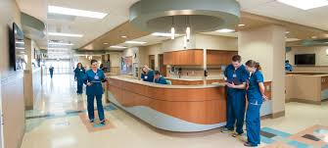
Contractor Guidelines continued
Patients, staff and visitors ALWAYS have the right-of-way in elevators and hallways
Clear pathways for patients, staff and visitors
Do not slow down day-to-day Adena Health operations

Slide 9
Contractor Guidelines continued
Use provided hand-cleaning products often, especially if the work space is in or near patient care
Reduce noise as much as possible
Provide the highest level of customer service to our patients, staff and visitors

Slide 10
General Privacy Guidelines
DO NOT look in patient or procedure rooms
Follow the “3 second look” rule
Avoid foul language and extremely loud conversations
Respect all Adena Health patients’, staff and visitors’ privacy
If a complaint is reported by a patient, visitor or staff member for inappropriate behavior or breach of privacy.
Adena Health reserves the right to remove any contractor that is reported for inappropriate
behavior or privacy breaches.

Slide 11
After-Hours Work Guidelines
To complete after-hours work, notify the Adena Health Project Manager at least 24 hours in advance

Slide 12
Utility Shutdowns
Notify Facility Operations during normal business hours at 740-779-7368 of shutdowns for electrical, plumbing, smoke detection and fire/sprinkler systems
Scheduled shutdowns require a 2-week notification in writing (including email)
Unanticipated shutdowns require a 48-hour notification
In the event of an unplanned utility outage immediately notify the following during normal business hours:
Facility Operations at 740-779-7368 and Security at 740-779-7505
Adena Health Safety Officer at 740-779-8681 or call the Switchboard Operator at 740-779-7500 and ask to be put through to the Adena Health Safety Officer cell phone for a utility outage emergency
After normal business hours call 740-779-7500 and have the Maintenance Technician on call/duty paged and notify Security

Slide 13
Infection Control Risk Assessment (ICRA)
Complete the Infection Control Risk Assessment (ICRA) before the project’s start to minimize patient risk to dust, moisture, and debris.
To obtain this form, the ICRA inspection monitor form and a copy of the Construction and Renovation Policy 800.016 contact the Adena Health Project Manager or Adena Health Safety Officer.
The ICRA must include:
Start and planned completion dates
Project description
Additional requirements (if applicable)
When the contractor portion is complete return the form via email to the Adena Health Project Manager, Safety Officer or Infection Prevention Manager. When all three have approved and signed off the Infection Control Permit will be issued. An electronic copy will be retained by Adena Health.

Slide 14
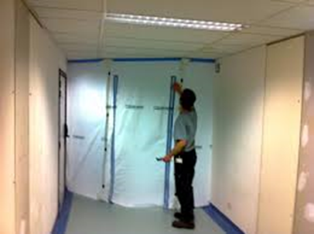
ICRA continued
A laminated copy of the Infection Control Permit must be posted at the project site until project completion
If the project exceeds the stated completion date, the Adena Health Project Manager must contact Infection Prevention for an extension
ICRA inspection monitor forms must be completed daily or weekly (frequency to be determined by Infection Prevention Manager)
Completed forms are to be returned to the Adena Health Safety Officer

Slide 15
ICRA continued
Infection Prevention staff, Environmental Health & Safety staff, or the department Director/Supervisor have the authority to stop the project if any part of the ICRA is violated
Contact the Adena Health Project Manager immediately if problems arise
Project may resume when issues are resolved to the satisfaction of the party that shutdown the project

Slide 16
Interim Life Safety Measures (ILSM)
If construction, renovation, or alteration activities might cause a failure in existing Life Safety Code building features, including but not limited to:
Emergency Exits
Access for emergency services
Fire extinguisher equipment
Fire alarms
Fire suppression systems
The ILSM grid is part of the Pre-Construction Risk Assessment (PCRA) and may be obtained from the Adena Health Project Manager or Adena Health Safety Officer (740-779-8681).
Fill out the ILSM grid during project development and monitor continuously until the project’s completion when required. Completed monitoring forms are to be returned to the Adena Health Safety Officer. Contact the Adena Health Safety Officer if you feel the dust you create may affect the smoke alarm system.

Slide 17
Containment Measures
The Adena Health Project Manager is responsible for:
Collaborating with the Department Director/Manager to ensure all patients will be moved prior to commencement of work
Collaborating with Adena Health Plant/Building Supervisor to ensure HVAC system isolation (blocking return air grills and duct work when necessary) is complete prior to commencement of work to avoid dust contamination of surrounding areas
Coordinating use of HEPA filtration units for negative air pressure to exhaust air

Slide 18
Containment Measures continued
The Contractor is responsible for:
Cleaning and sealing ceiling vents.
Wiping down tools and equipment with a damp cloth or bagging them before bringing them through the hospital. This includes tool/trash carts, covers and wheels.
Using fire-rated plastic for all short term jobs.
Taping barrier seams to make sure they are fully sealed – NO DROOPING!
Installing temporary floor-to-deck barriers as needed.
Installing solid-wall barriers for longer projects as needed.
Using tightly sealed barriers/control cubes to contain all work, including holes in the walls, ceilings and floors.

Slide 19
Containment Measures continued
Contractor responsibilities continued:
Properly sealing doors into barrier areas with zipper
DO NOT use control cubes with broken zippers
Sealing wall/ceiling/floor openings with an approved UL sleeve and Hilti, STI or 3M UL listed fire stop systems (obtain copy of Maintaining Fire/Smoke Rated Assemblies policy 900.006 from Adena Health Dir Facility Planning and Construction or Adena Health Safety Officer).
Do any assembly or cutting of pipe, wood or other materials inside the designated work area or outside of the building.
Use walk-off mats (sticky or moistened carpet mats) between your work area and the rest of the building (peel sticky mats to the next layer as soon as they lose adhesive quality).
Vacuum carpet mats daily.

Slide 20
Containment Measures High Risk Areas
Use the following special requirements for high risk areas:
Construct an anteroom to ensure an airtight enclosure of the project site
Use HEPA filtration units for negative air pressure within the work site
Check ventilation filters regularly for leaks or clogs
Use PPE as needed
Remove disposable coveralls and disposable booties before leaving the demolition area
Use HEPA vacuums (inside anteroom) to vacuum clothing/boots upon exit of project site when disposable coveralls are not required

Slide 21
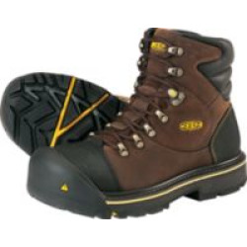
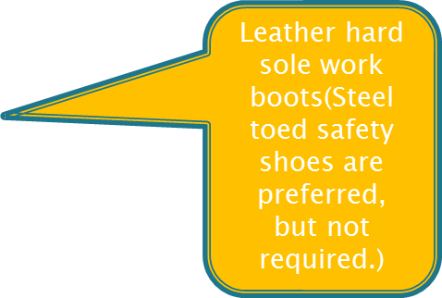
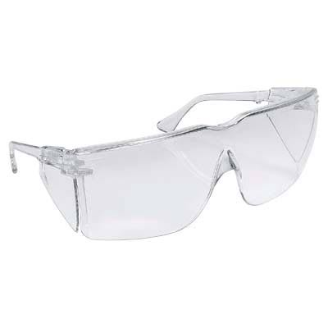
PPE Requirements
These are minimum PPE requirements. Additional PPE may be required based on the task and/or scope of work performed. See your supervisor if you are unsure of the PPE required for the task(s) you are performing.
Safety Glasses (must be ANSI Z87 approved with fixed side shields)

Slide 22
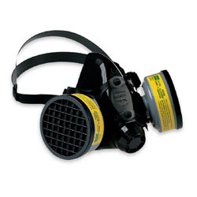
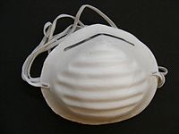
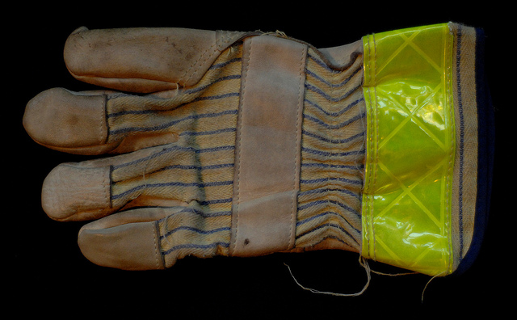
PPE Requirements continued
These are minimum PPE requirements. Additional PPE may be required based on the task and/or scope of work performed. See your supervisor if you are unsure of the PPE required for the task(s) you are performing.
Respiratory protection (applicable for they type of work being done)
Gloves (applicable for the type of work being done)

Slide 23
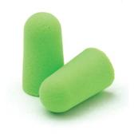
PPE Requirements continued
Hearing protection in areas where the noise level exceeds 85 db. (If you have to raise your voice to be heard by someone within 3’ of you, the noise level is above 85 db.)

Slide 24
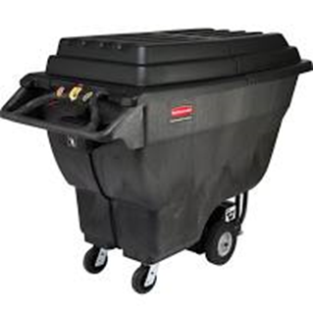
Waste Guidelines
Dispose of all waste.
Construction site waste must be disposed of daily. If waste is being removed from occupied buildings it must be done using a covered dumpster.
Contractors requiring waste collection on site must coordinate with the Adena Health Project Manager.
Location, size, duration and frequency of dumps must be communicated to the Adena Health Project Manager.

Slide 25
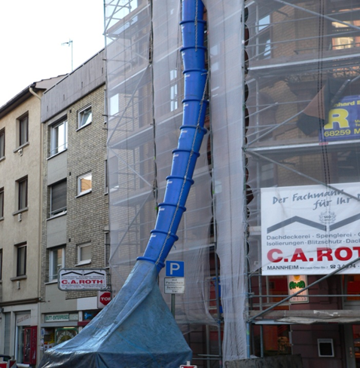
Waste Guidelines continued
If a construction chute is used, it must be sealed to prevent the accidental spread of debris

Slide 26
Cleaning Guidelines
Establish traffic patterns to prevent dust from being taken outside the construction area and clean up all dust immediately
Clean all areas adjacent to the project site often, using a damp mop (change water often) of HEPA vacuum to control dust
Do not use a broom as it stirs up dust

Slide 27
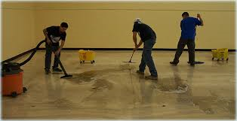
Cleaning Guidelines continued
When project is complete, clean the work area
When work area is clean, carefully remove barriers
Contact Environmental Services (740-851-3237) to clean the completed project area before allowing patients to return

Slide 28
Electrical Safety Guidelines
Ensure all electrical equipment is UL rated and in good working condition
Do not plug equipment into red outlets
A Ground Fault Circuit Interrupter (GFCI) must be plugged into the outlet before plugging in any other equipment and cords.

Slide 29
Machine and Power Tool Safety
Hand and power tools are a common part of our everyday lives and are present in nearly every industry. These tools help us to easily perform tasks that otherwise would be difficult or impossible. However, these simple tools can be hazardous and have the potential for causing severe injuries when used or maintained improperly. Special attention toward hand and power tool safety is necessary in order to reduce or eliminate these hazards.
Five Basic Rules to Prevent Injuries:
Keep all tools in good condition with regular maintenance
Use the right tool for the job
Examine each tool for damage before use and do not use damaged tools
Operate tools according to the manufacturers’ instructions
Properly use the appropriate PPE

Slide 30
Machine and Power Tool Safety Continued
Tool Selection is Very Important:
Select the right tool for the job
Consider the tools shape and size – the tool should be comfortable to hold
Do not select undersized tools for the job
Consider the quality of the tool including its sharpness for cutting
Select power tools designed to have minimal vibration
Select power tools that provide guarding and other safety features such as an automatic shutoff, safety trigger, shield or kickback guard.
Select electric power tools that are double-insulated
Select power tools that have the Underwriters Laboratories symbol
Select spark-resistant tools when working around flammables or explosive material
Select insulated hand tools when working around electricity
Select battery powered tools for wet locations

Slide 31
Machine and Power Tool Safety Continued
Using Hand Tools:
Select and use the appropriate PPE (i.e., safety glasses, leather gloves, steel toed shoes)
Read and follow the manufacturer’s instructions
Create a safe work area by keeping people at a safe distance and removing objects that may get in the way
Use the tool as it is attended to be used (i.e., don’t use a screwdriver as a punch, pry or wedge)
Disconnect electric cords when working on or around electric appliances
Use the correct size tool for the job (i.e. match the screwdriver with the screw head)
Pull wrenches and levers towards yourself-this will provide better control

Slide 32
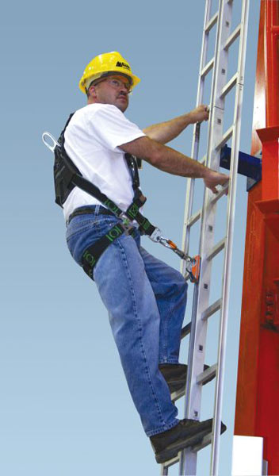
Ladder Safety Guidelines
Always maintain a 3-point (two hands and a foot, or two feet and a hand) contact on the ladder when climbing. Keep your body near the middle of the step and always face the ladder while climbing.
Only use ladders and appropriate accessories (ladder levelers, jacks or hooks) for their designed purposes.

Slide 33
Ladder Safety continued
Ladders must be free of any slippery material on the rungs, steps or feet.
Do not use a self-supporting ladder (e.g., step ladder) as a single ladder or in a partially closed position.
Do not use the top step/rung of a ladder as a step/rung unless it was designed for that purpose.
Use a ladder only on a stable and level surface, unless it has been secured (top or bottom) to prevent displacement.

Slide 34
Ladder Safety continued
Do not place a ladder on boxes, barrels or other unstable bases to obtain additional height.
Do not move or shift a ladder while a person or equipment is on the ladder.
An extension or straight ladder used to access an elevated surface must extend at least 3 feet above the point of support. Do not stand on the three top rungs of a straight, single or extension ladder.

Slide 35
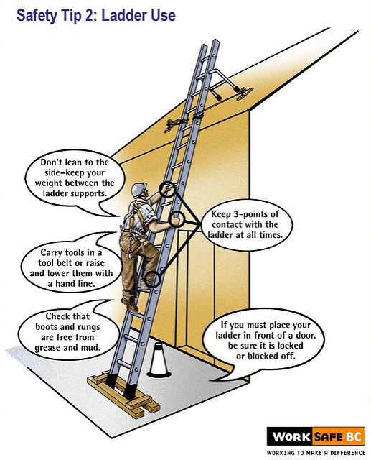
Ladder Safety continued
The proper angle for setting up a ladder is to place its base a quarter of the working length of the ladder from the wall or other vertical surface. A ladder placed in any location where it can be displaced by other work activities must be secured to prevent displacement or a barricade must be erected to keep traffic away from the ladder.

Slide 36
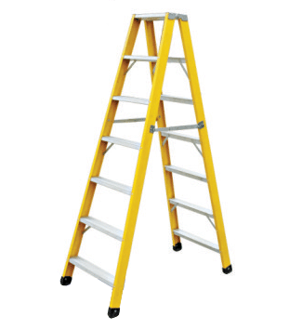
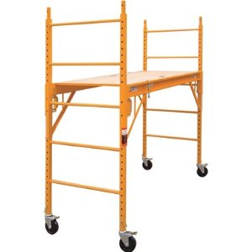
Ladder Safety continued
Be sure that all locks on an extension ladder or any elevated work platform are properly engaged.
Do not exceed the maximum load rating of any elevated work platform or ladder. Be aware of the load rating and of the weight it is supporting, including the weight of any tools or equipment.

Slide 37
Fall Prevention Guidelines
Fall protection is required for any work conducted at a height of 6’ or greater
Wear a harness and always stay connected
Make sure your harness fits
Use guardrails or lifelines
Inspect all fall protection equipment before use
Guard or cover all holes, openings, and skylights
DON’T disconnect from the lifeline
DON’T work around unprotected openings or skylights
DON’T use defective equipment
Information on ladder safety and fall prevention obtained from osha.gov

Slide 38
Safety Data Sheets
Contractors will provide Safety Data Sheets (SDS) to the Adena Health Safety Department Coordinator for any materials that will be used on site
The SDS for any materials in the Adena Health area where work is being performed will be made available to the Contractor upon request.
Please submit SDS requests to the Adena Health Safety Department Coordinator
Jennifer Abner

Slide 39
Hazardous Chemical Guidelines
Do not use any extremely hazardous chemicals, aerosol sprays, or cleaning products that produce heavy fumes or odors, without first notifying the Adena Health Safety Officer (740-779-8681)
Observe all safety and environmental precautions when using hazardous chemicals on Adena Health property
Dispose of all chemicals off site. If you bring it – take it away when you leave (including empty cans, bottles, etc.)

Slide 40
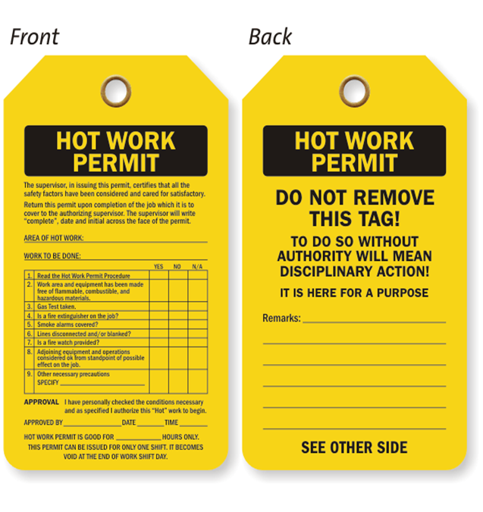
Hot Work Permits
Obtain a Hot Work Permit for all welding, cutting, grinding or any other type of work that might create a spark
Obtain Hot Work Permits through Security (740-779-7505)
See Adena Health Hot Work Permit Policy 900.005 for details

Slide 41
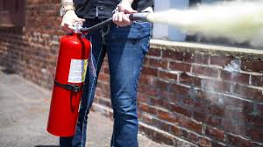
Hot Work Permits continued
Once the Hot Work Permit is obtained, the contractor must contact Security (740-779-7505) in person before and after the work is completed to sign off on where the work is being performed so the fire alarm system can be isolated if necessary
The Hot Work Permit must be returned to the issuer once Hot Work is completed
The Contractor must provide fire extinguishers and blankets (if necessary)

Slide 42
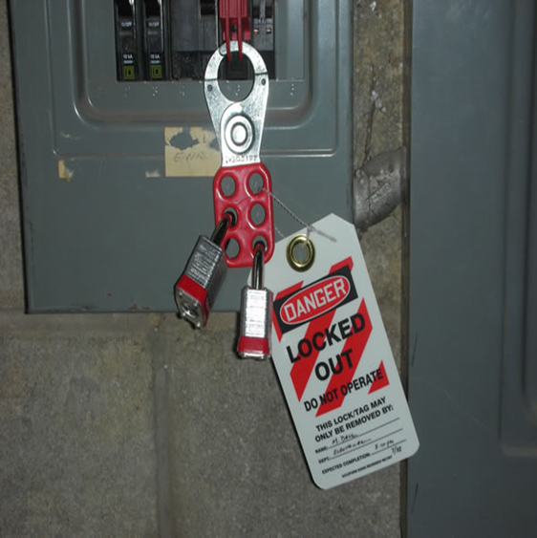
Lockout/Tag-out Guidelines
Facility Operations approves the lockout/tag-out of equipment before work on the equipment is performed and a point of contact is established.
When Adena Health personnel lockout/tag-out a piece of equipment for a contractor, the contractor is also required to add a lock or tag using a multilock device.
All locks must have a tag with contact information.

Slide 43
Confined Space Guidelines
Coordinate a permit for all entries into any confined space through your Adena Health Project Manager. Obtain a copy of Adena Health Confined Spaces Program Policy 800.032 and use permits and forms as appropriate.
The Contractor will inform the Adena Health Project Manager of contracted personnel procedures for entering confined spaces.
The Adena Health Project Manager will inform the Contractor of all the procedures and precautions in or near the confined space and will conduct a debrief with the Contractor at the end of the job to learn of any hazards found or created during entry.

Slide 44
Bloodborne Pathogens Guidelines
Bloodborne pathogens are viruses (such as HIV and Hepatitis B & C) found in blood or certain body fluids
A person has to come in direct contact, usually through a needle stick, to become infected
You cannot get a bloodborne pathogen infection by casual contact

Slide 45
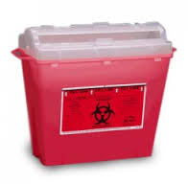
Bloodborne Pathogens Guidelines continued
If you are exposed to blood or body fluids:
what you are doing
Dispose of any sharps involved in an approved sharps container
Wash the exposed area with soap and water
Report it to your Supervisor

Slide 46
Injury Guidelines
Contracted employees must notify their Supervisor of injuries and follow company policy and procedures.
The Supervisor must notify the Adena Health Project Manager and provide an incident report.
In the event that a construction accident occurs, the construction supervisor present at the time will contact 911 for any medical emergency as deemed necessary.
It is important to know the physical address of the location of the jobsite in the event you need to call 911.
The construction supervisor will also contact Adena Security at 740-779-7505 and request hospital security to be dispatched to the accident scene.

Slide 47
Ohio Emergency Codes
Code Red Fire
Code Adam Infant/Child Abduction
Code Black Bomb/Bomb Threat
Code Gray Severe Weather
Code Orange Hazardous Material Spill
Code Blue Medical Emergency - Adult
Code Pink Medical Emergency - Pediatric
Code Yellow Disaster
Code Violet Violent Person
Code Silver Person with Weapon / Hostage Situation
Code Brown Missing Adult Patient/Visitor
Code Green Evacuation of Building
Code Email Check your email for Instructions

Slide 48
Ohio Emergency Codes continued
Code Red: FIRE
Follow the RACE / PASS guidelines
R: Rescue people in the fire area
A: Activate the Alarm (pull box)
C: Contain the fire (close doors)
E: Evacuate (people from the area)

Slide 49
Ohio Emergency Codes continued
When a code is announced over the public address system you must:
Cease any electrical and hot work
Secure ladders and clear all equipment from the hallways
Follow the direction of the Adena Health Project Manager, Adena Security, Adena Health Safety Officer and/or Department Director/Manager

Slide 50
Workplace Violence
Adena Health strictly prohibits violence in the workplace by any individual, in any form. Violence can be defined as any physical assault, threatening behavior or verbal abuse occurring in the work setting or related to the workplace.
Report all incidents of workplace violence immediately.
For Main Campus – Contact Security/Human Resources Department to report threatening behavior. Call 27555, state CODE Violet and location for violent/potentially violent or escalating behavior.
For Regional Sites – Contact the Site Manager and the Main Campus Security Officer on duty or Human Services Department to report threatening behavior.
If you are in an isolated area and are unable to reach a phone, use whatever is available to draw attention to you, i.e. pull a fire alarm box, etc.
If you are aware of potential workplace violence (i.e. restraining order, incidence of violence outside the workplace), notify your department director and the Main Campus Security Officer on duty.
A Workplace Violence “Tool Kit” was created that has additional information that may be needed. The tool kit has policy references, various forms, additional contact information etc. You can find this toolkit by accessing the Adenanet and clicking on the following: Departments/ Safety/ Workplace Violence.

Slide 51
Thank You for Promoting a Safety Culture
If you have any questions, please contact any member of the Environmental Health & Safety Team
Director, Environmental Health & Safety (System Safety Officer)
Rogena Hiles x28681 or rhiles@adena.org
Safety Department Coordinator
Jennifer Abner x28166 or jabner@adena.org
Regional Safety Coordinator
Erik Davis X27403 or edavis@adena.org
Emergency Management Coordinator
Thomas Royster x27394 or troyster@adena.org

